Slide 1
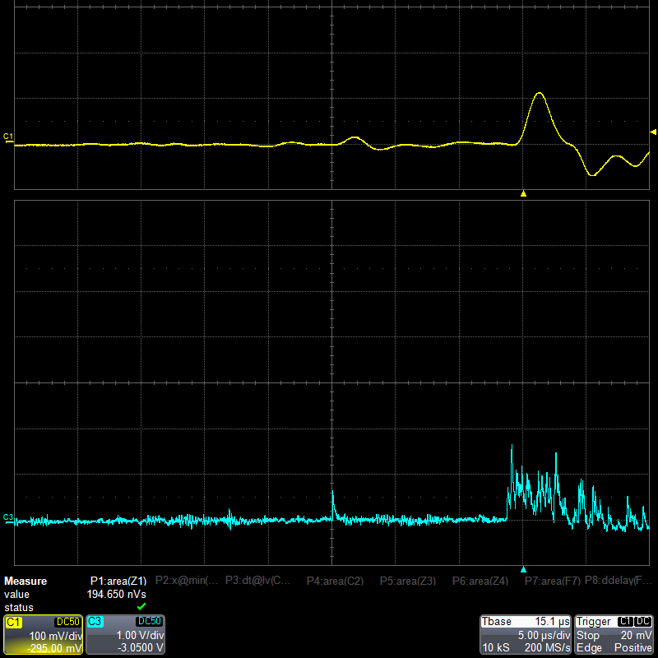
S₂
S₁

Slide 2
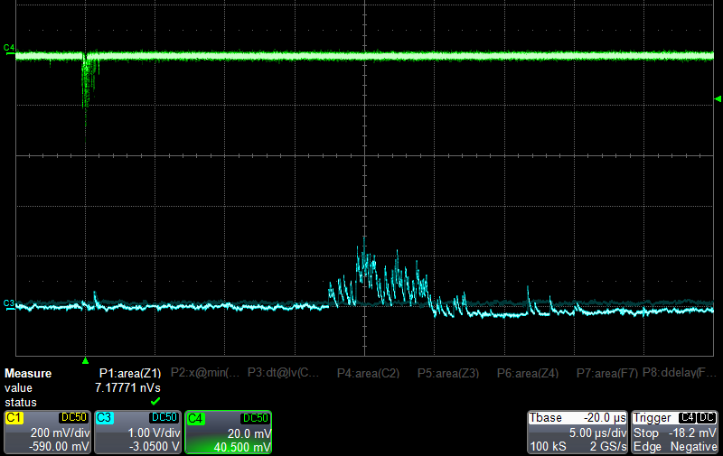
Trigger (BGO counter)
S₂
S₁

Slide 3
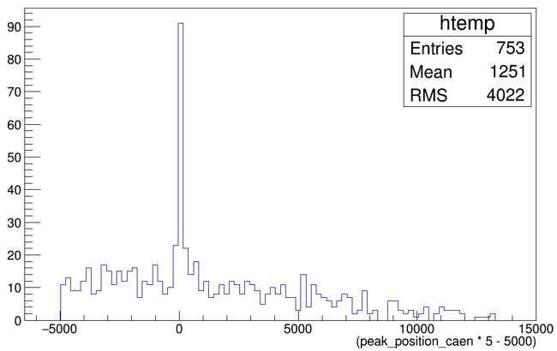
Events
Peak position relative to the trigger (ns)

